Slide 1
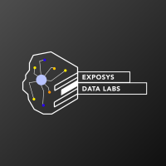
Customer Segmentation
By: Mohammed Touseef
Position: Data science intern

Slide 2
motivation
Let's imagine you're owning a supermarket mall and through membership cards, you have some basic data about your customers like Customer ID, age, gender, annual income and spending score, which is something you assign to the customer based on your defined parameters like customer behavior and purchasing data .based on this parameters we can provide variety of discounts & offers which in return we get more customers in the future resulting to more profit.

Slide 3
Aim
The main aim of this problem is learning the purpose of the customer segmentation concepts, also known as market basket analysis, trying to understand customers and separate them in different groups according to their preferences, and once the division is done, this information can be given to marketing team so they can plan the strategy accordingly.

Slide 4
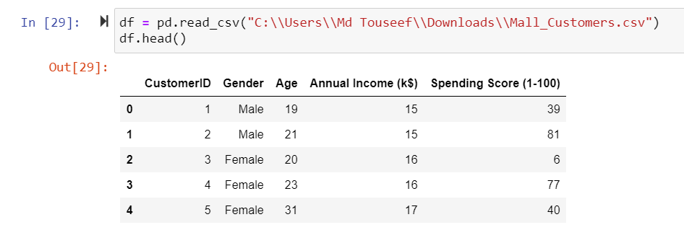
Reading the given dataset

Slide 5
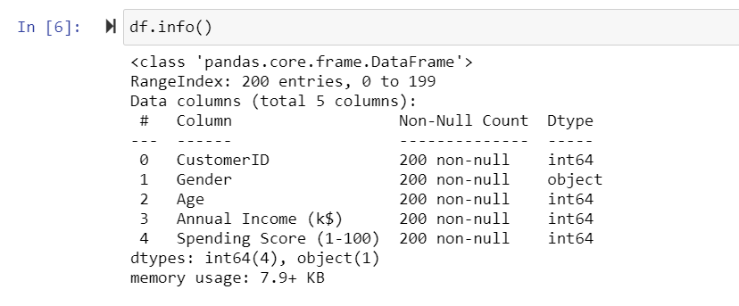
Basic info of given dataset

Slide 6
Feature details
This dataset is composed by the following five features:
CustomerID: Unique ID assigned to the customer
Gender: Gender of the customer
Age: Age of the customer
Annual Income (k$): Annual Income of the customer
Spending Score (1-100): Score assigned by the mall based on customer behavior and spending nature.
In this particular dataset we have 200 samples to study.

Slide 7
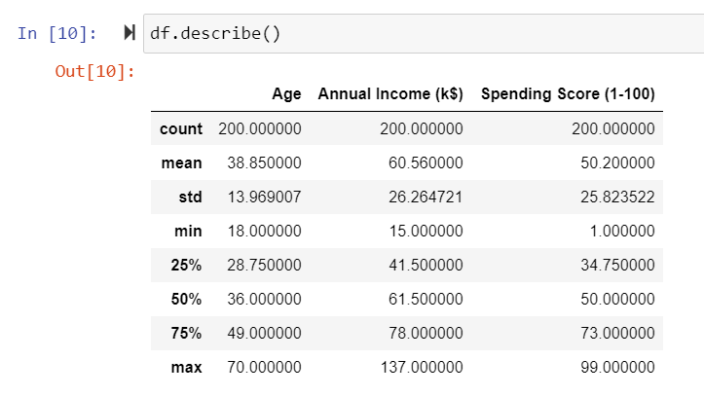
Description of the dataset

Slide 8
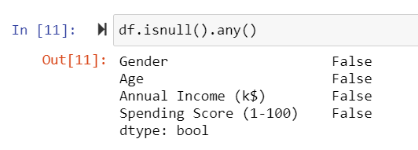
Checking for null & duplicate values

Slide 9
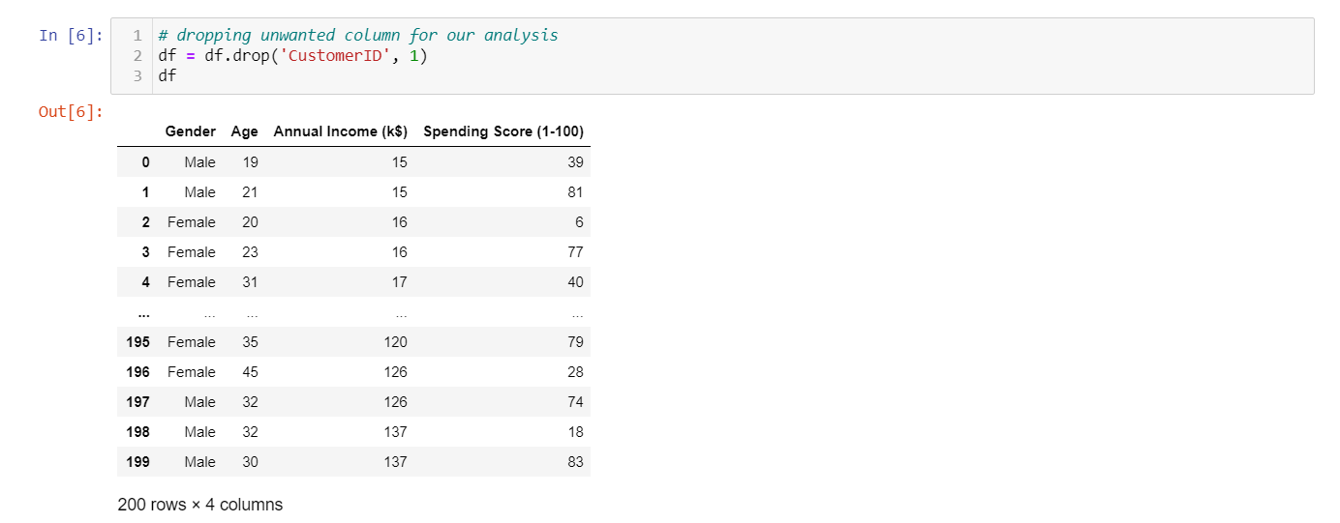
Dropping unwanted features for our analysis

Slide 10
Visualization

Slide 11
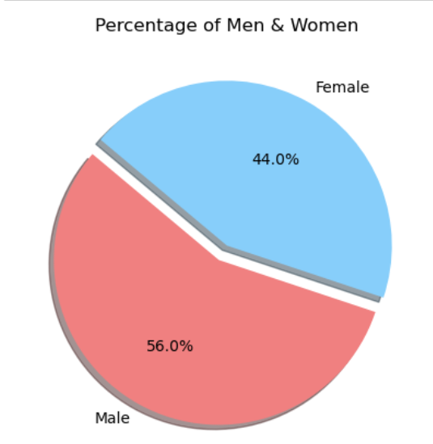
What’s the percentage of Male & Female in total customers?

Slide 12
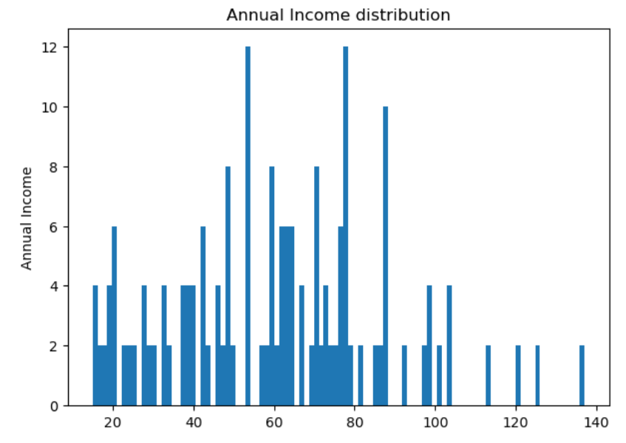
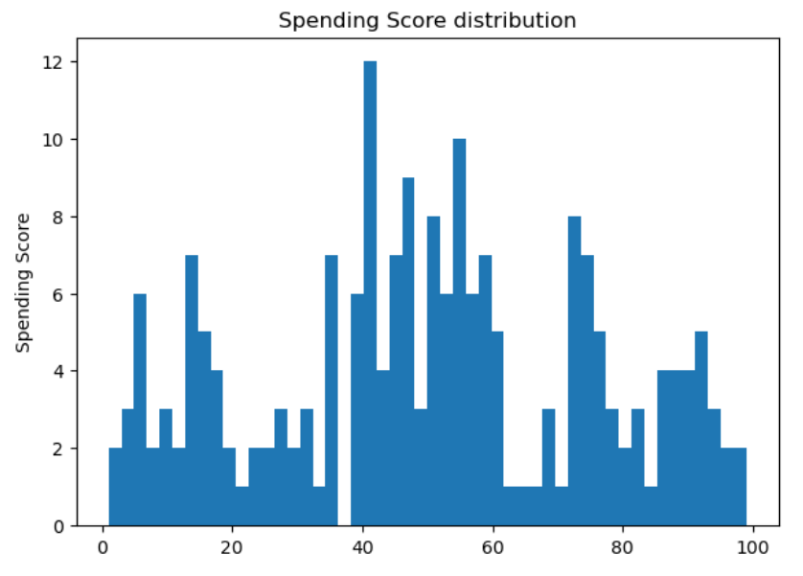
FREQUENCY DISTRIBUTION

Slide 13
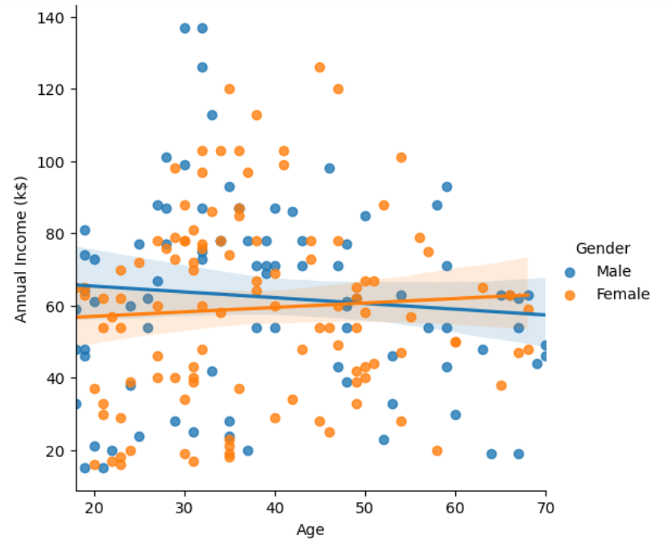
Which age group earns more income?

Slide 14
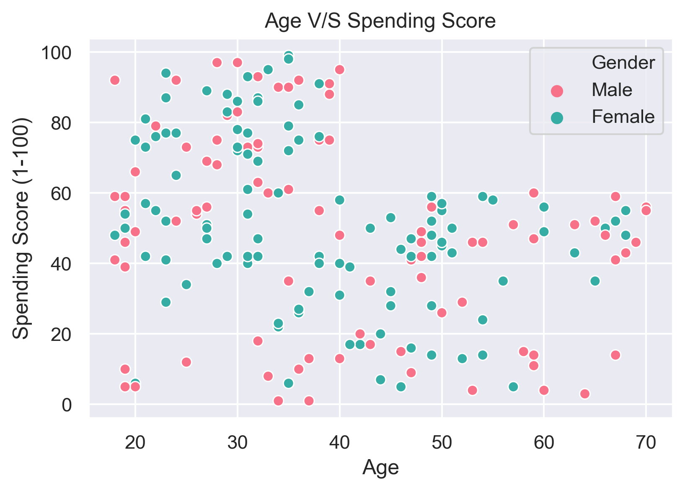
Will spending score decrease after certain age?
We can find a relation that people with age >= 40 have spending rate less than 60

Slide 15
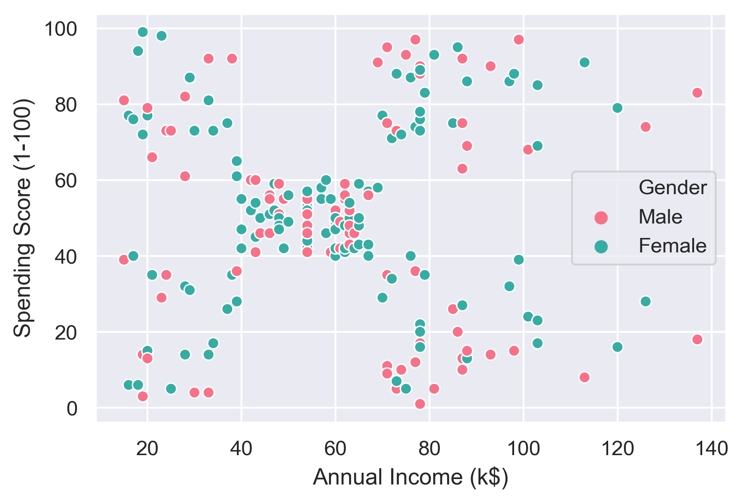
Are there any clusters in annual income and spending score ?

Slide 16
clustering

Slide 17
What is clustering ?
Clustering is one of the most common exploratory data analysis technique
We can define it has the task of identifying subgroups in the data such that data points in the same subgroup (cluster) are very similar while data points in different clusters are very different
We use similarity measure such as Euclidean-based distance or correlation-based distance.
Some of the most popular applications of clustering is customer segmentation ,image compression & document clustering

Slide 18
What is K-Means Clustering?
K-means algorithm is an iterative algorithm
The algorithm tries to partition the dataset into k pre-defined distinct non-overlapping cluster
Each data point will belong to only one cluster
It assigns data points to a cluster such that the sum of the squared distance between the data points and the cluster’s centroid
The less variation we have within clusters, the more homogeneous the data points are within the same cluster.

Slide 19
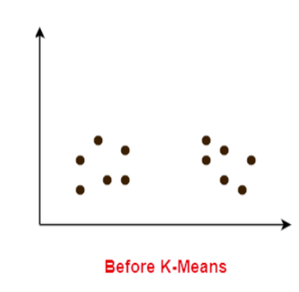
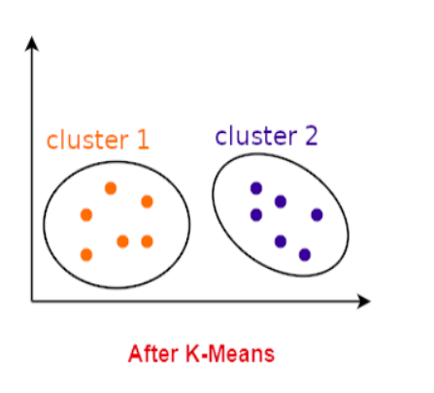
Pictorial representation of k means algorithm
K-Means

Slide 20
How to choose K(centroids) for clustering ?
Elbow Method
Silhouette Coefficient Method

Slide 21
Clustering for 2 Features

Slide 22
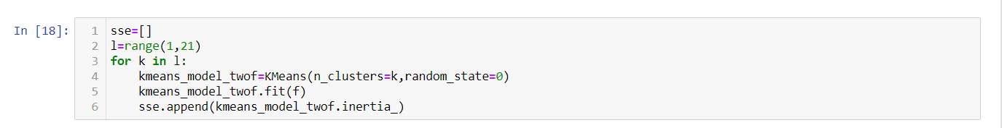
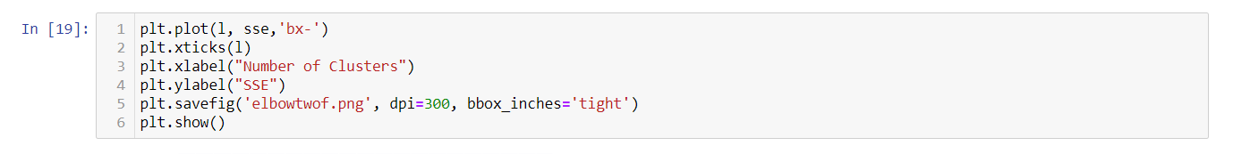
Elbow Method

Slide 23
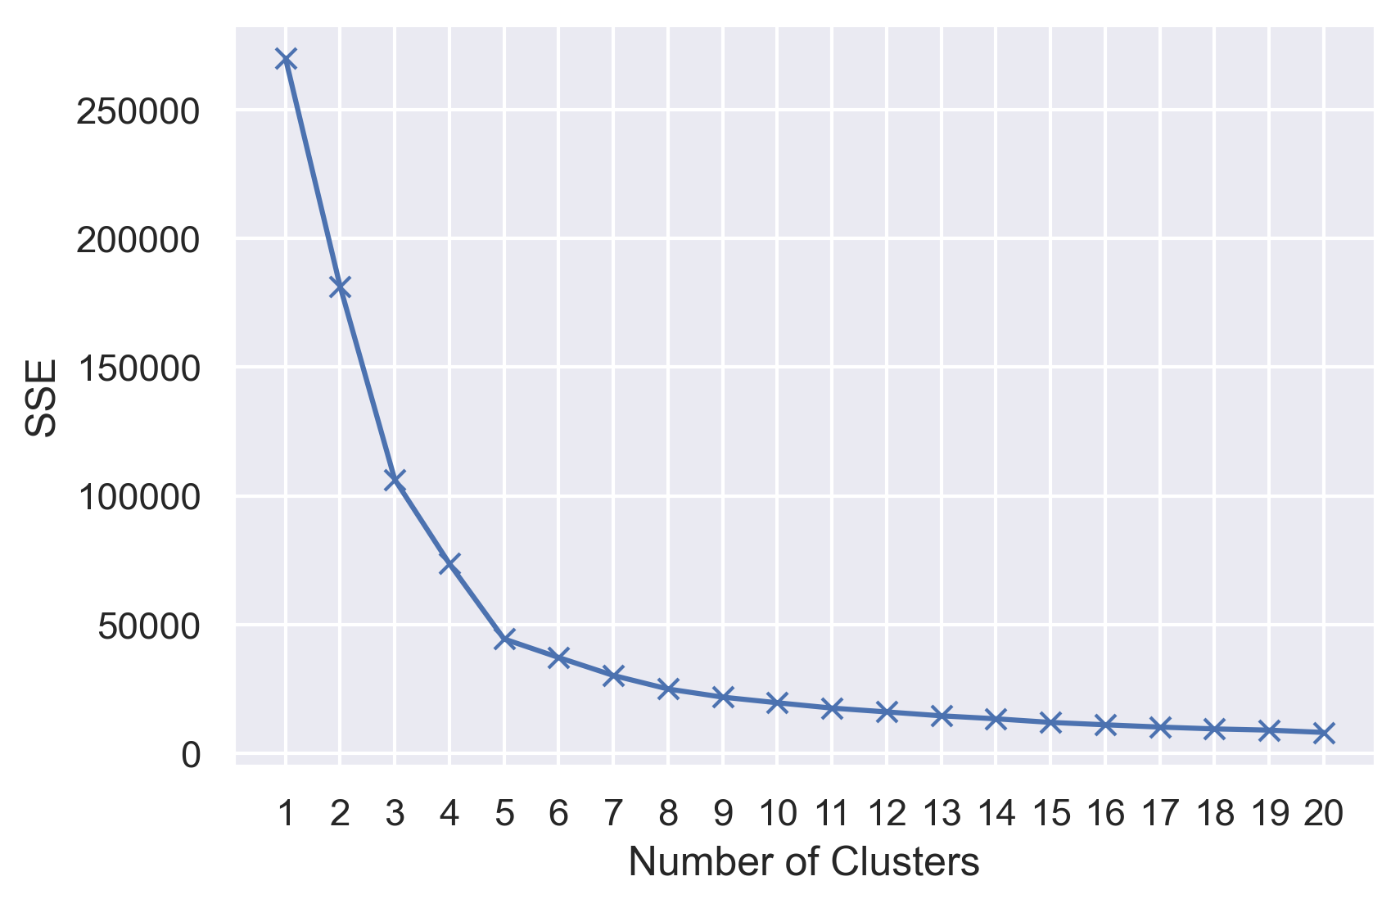
Elbow Method Plot

Slide 24
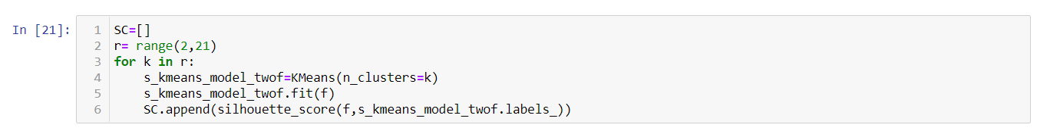
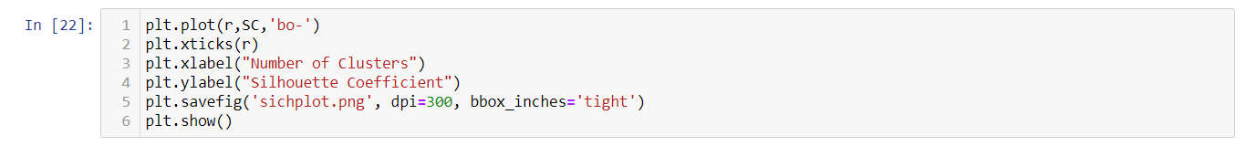
Silhouette Coefficient Method

Slide 25
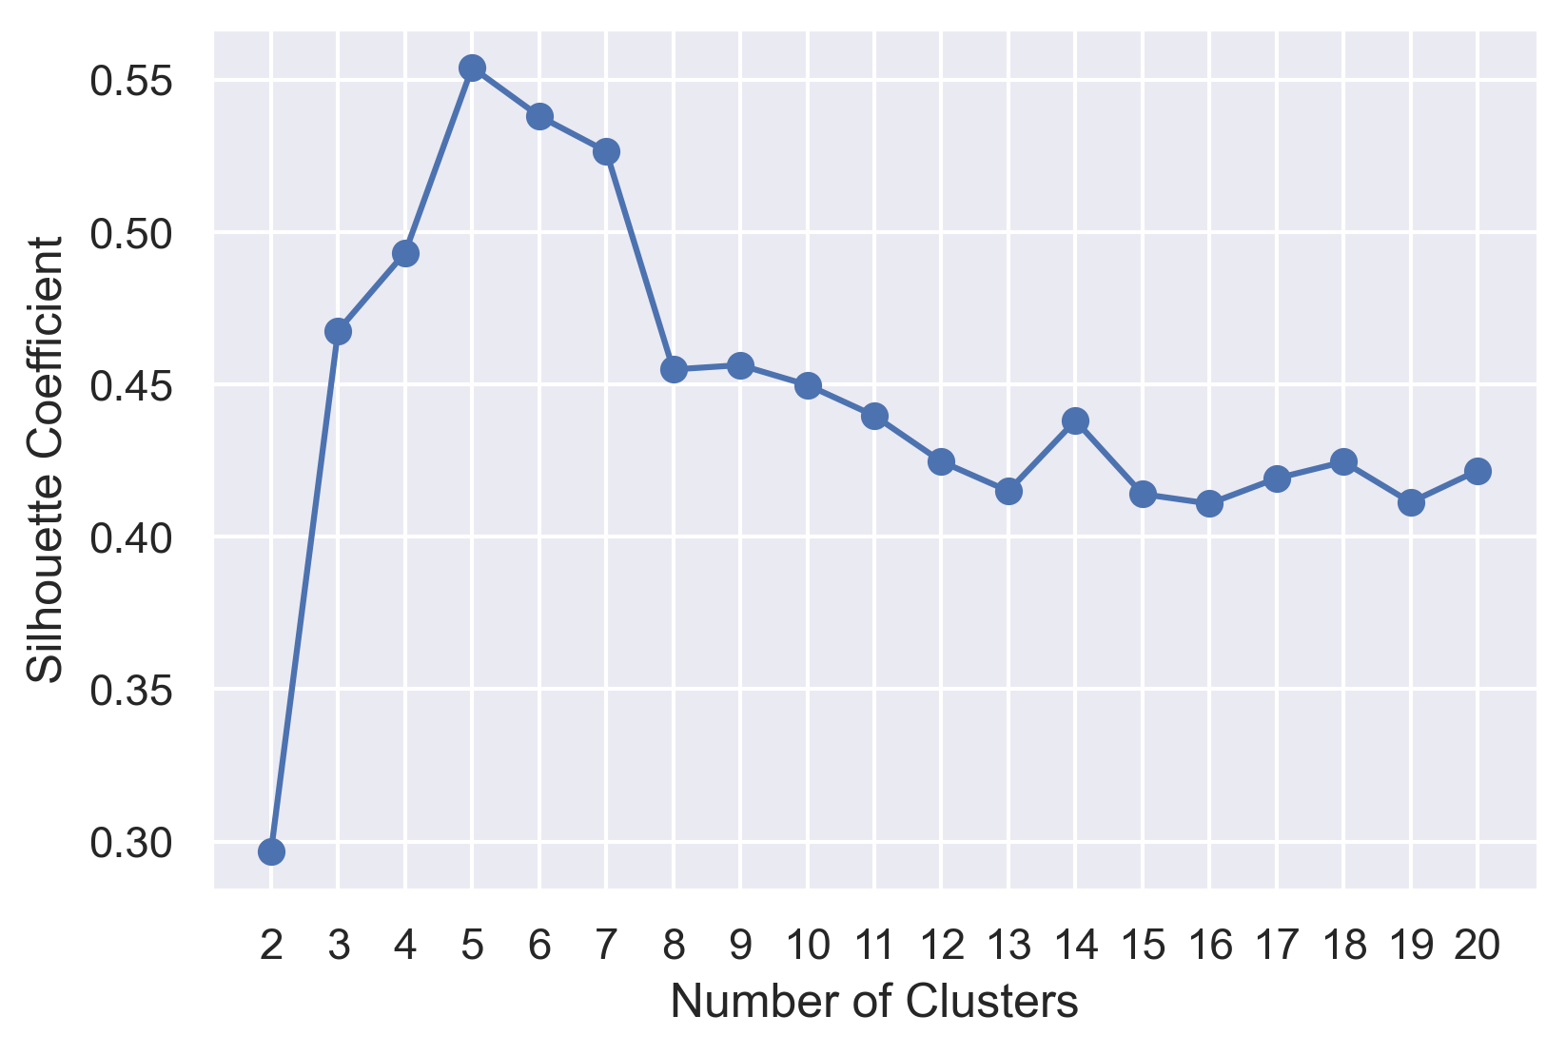
Silhouette Coefficient Method Plot

Slide 26
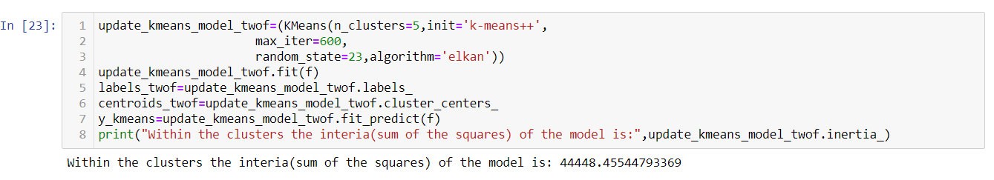
K Means Algorithm

Slide 27
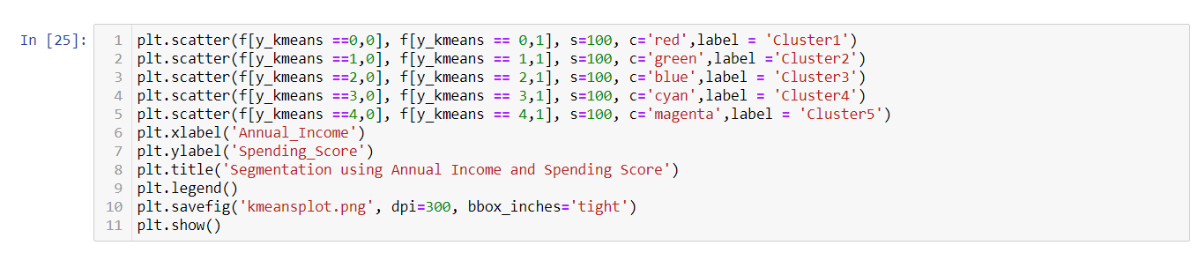
K Means Plotting

Slide 28
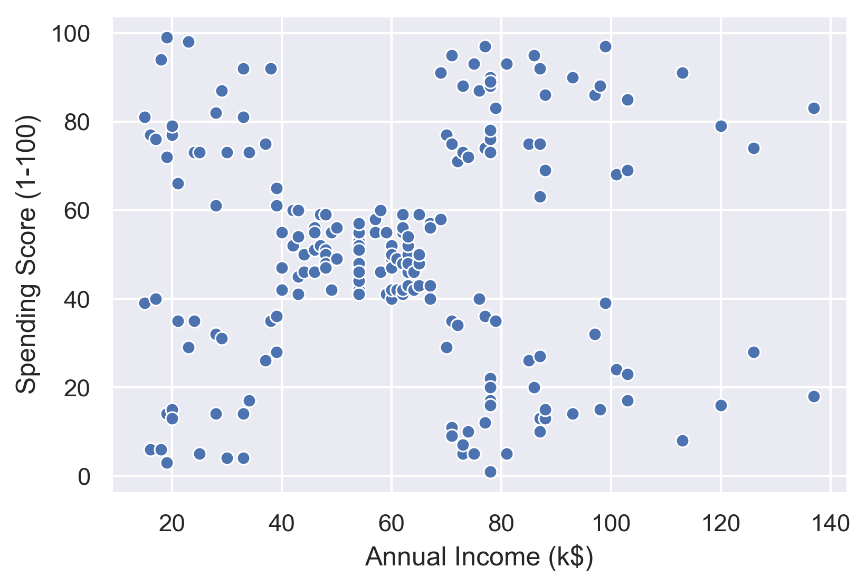
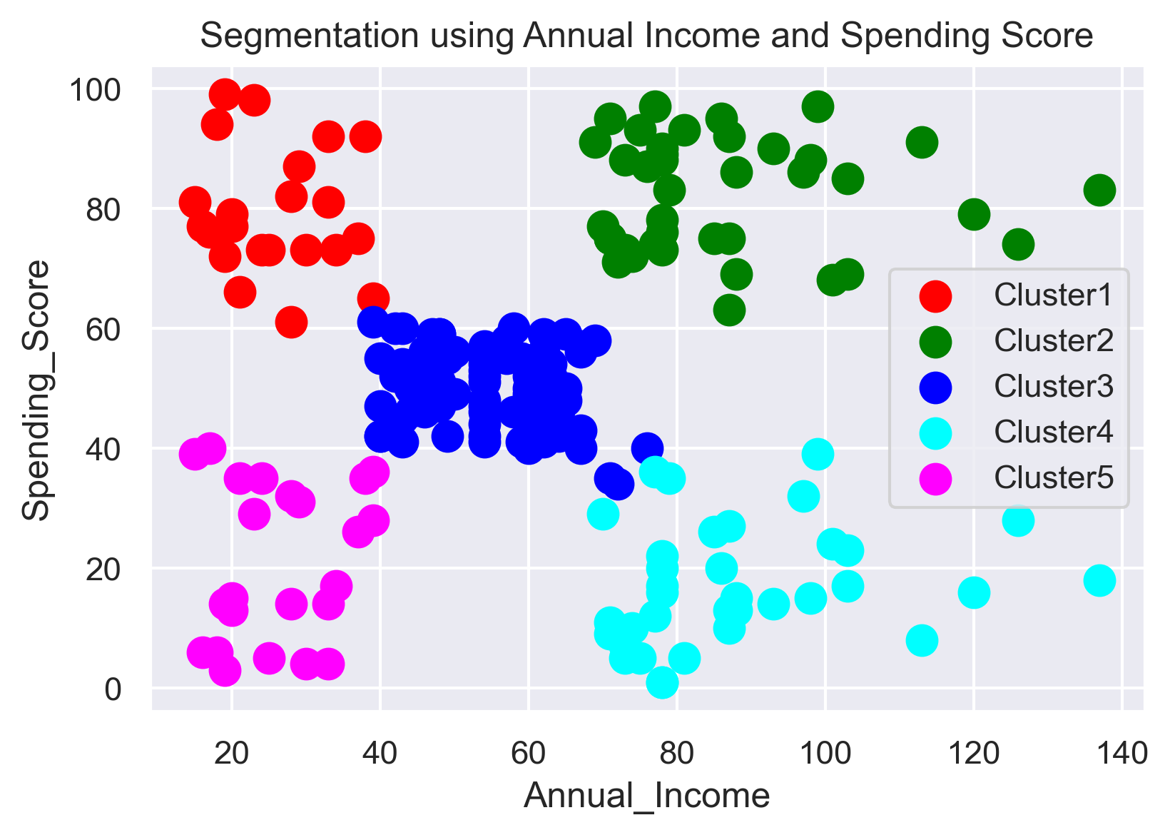
Before & After Applying K-Means
K-Means

Slide 29
Clustering for 3 Features

Slide 30
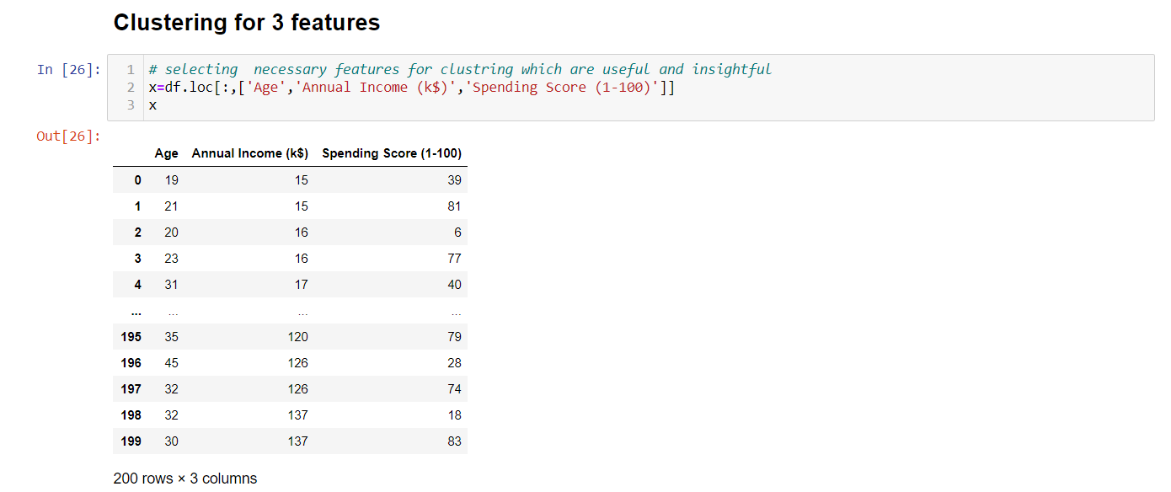
Selecting the 3 important features

Slide 31
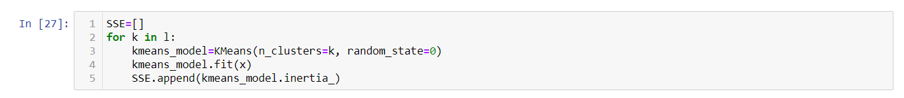
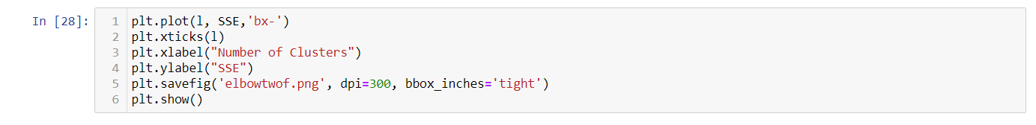
Elbow Method

Slide 32
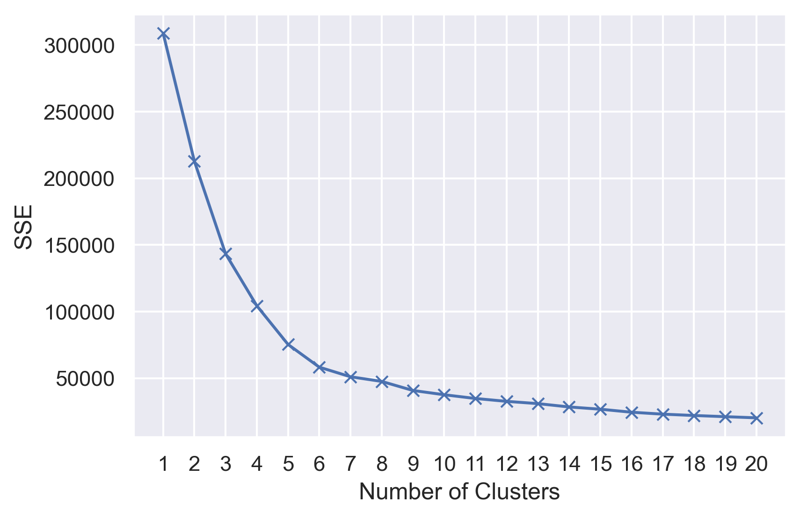
Elbow Method Plot

Slide 33
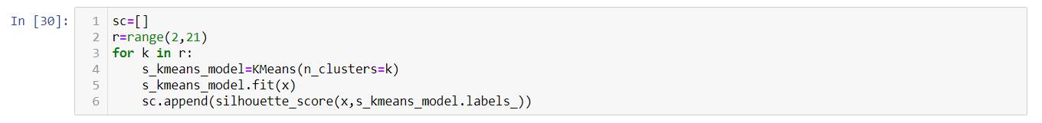
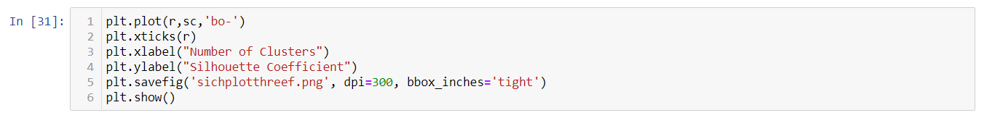
Silhouette Coefficient Method

Slide 34
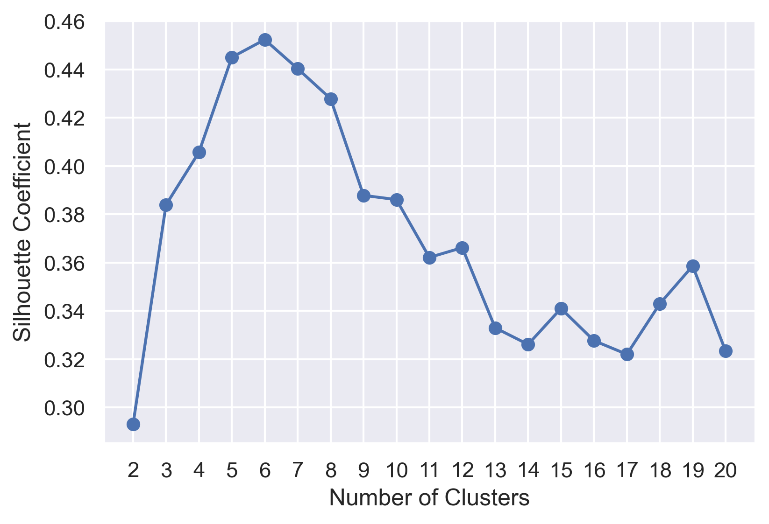
Silhouette Coefficient Method Plot

Slide 35
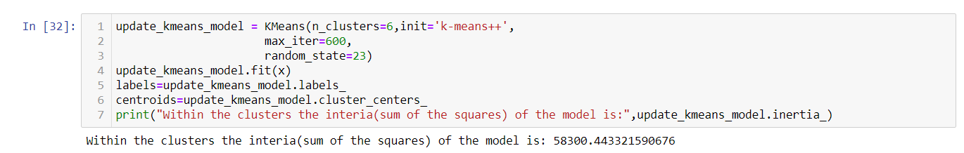
K Means Algorithm

Slide 36
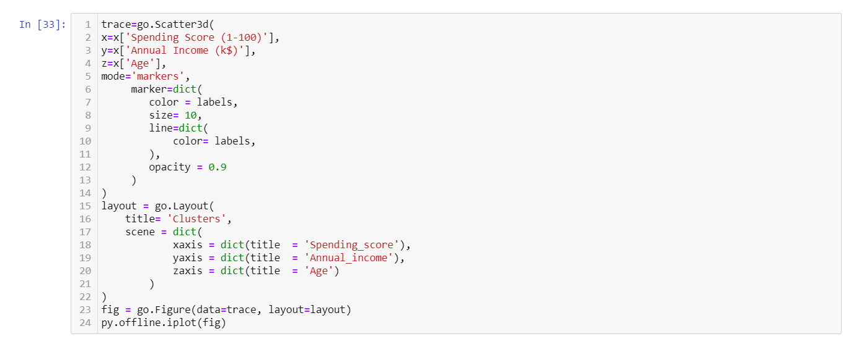
K Means Plotting

Slide 37
Thank you

